Slide 1
Accurate acquisition cost prediction for optimal reserve planning
And more specifically today:
Purchase price, Reserve selection and Bargain Sales

Slide 2
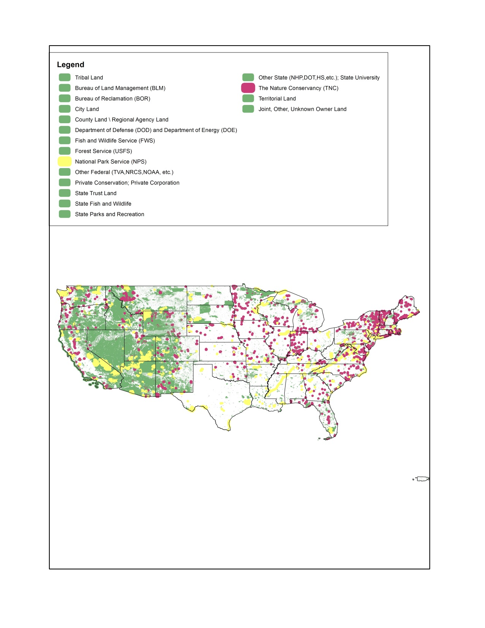
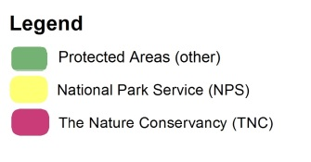
Protected Areas Conservation costs in the U.S.
Lack of data
(use of proxies)
Spatial aggregation
(and grain discrepancy)

Slide 3
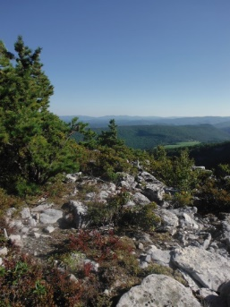
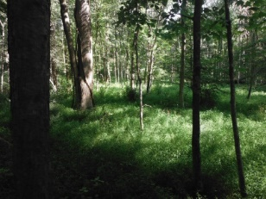
Protected Areas Agricultural land value

Slide 4
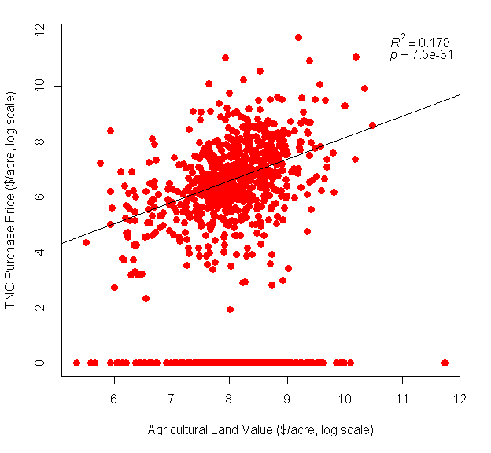
How wrong could we be?
Actual purchase price of areas acquired by TNC against average agricultural land value in their county (USDA NASS data)

Slide 5
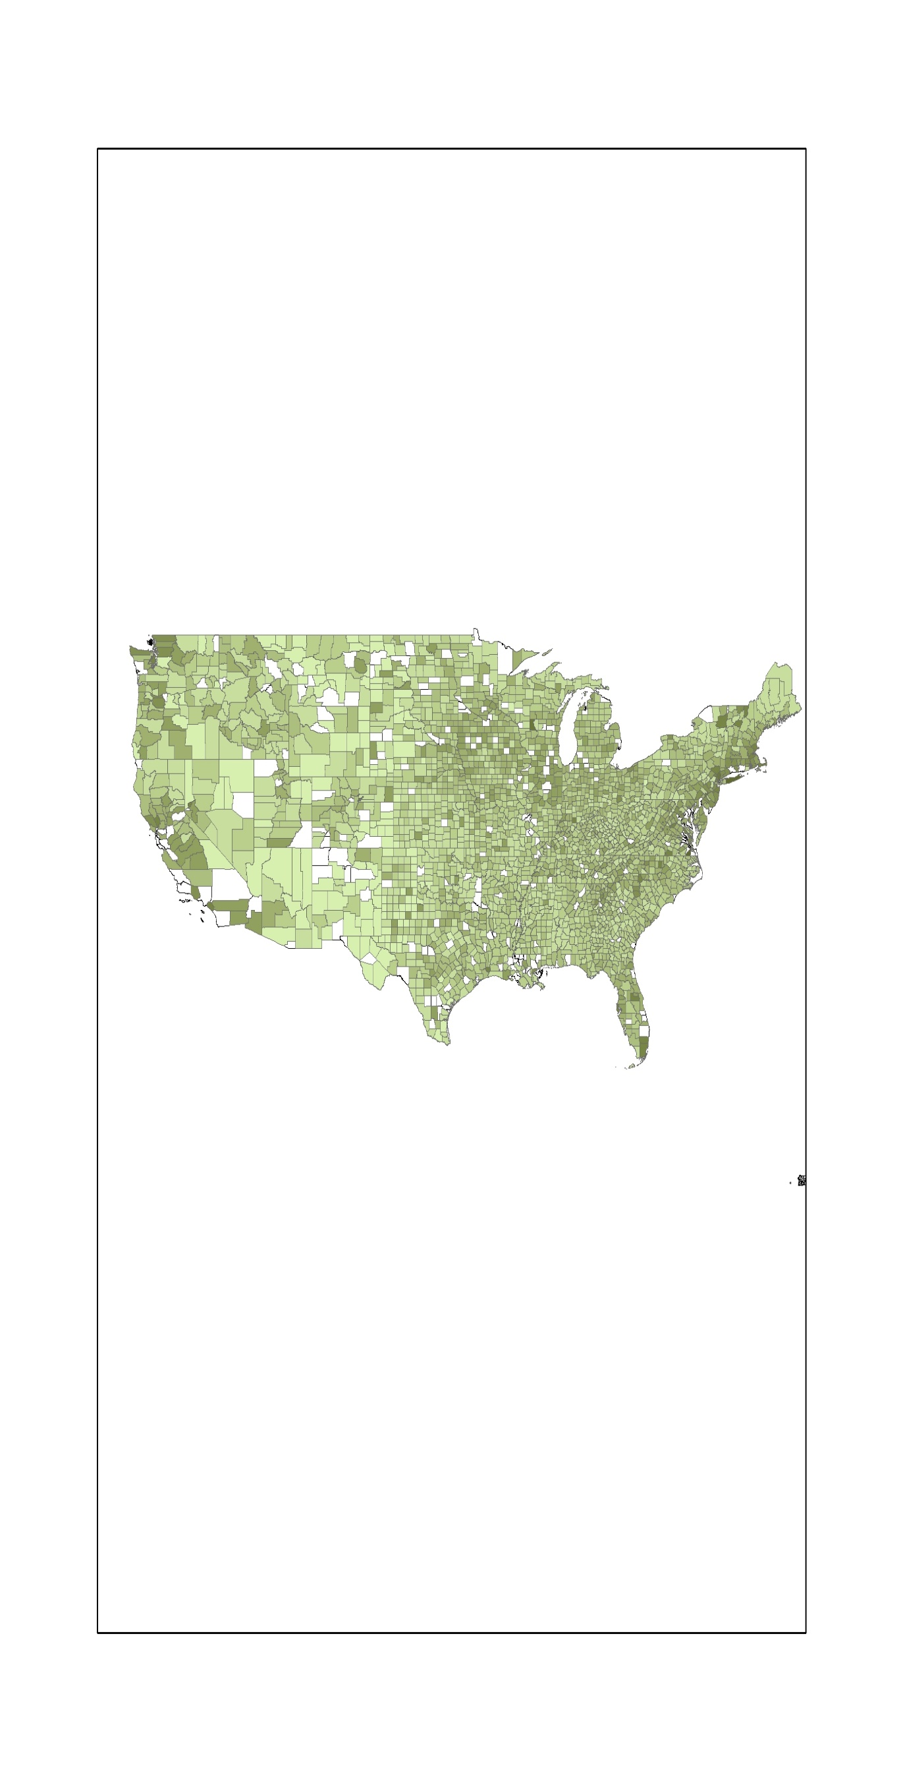
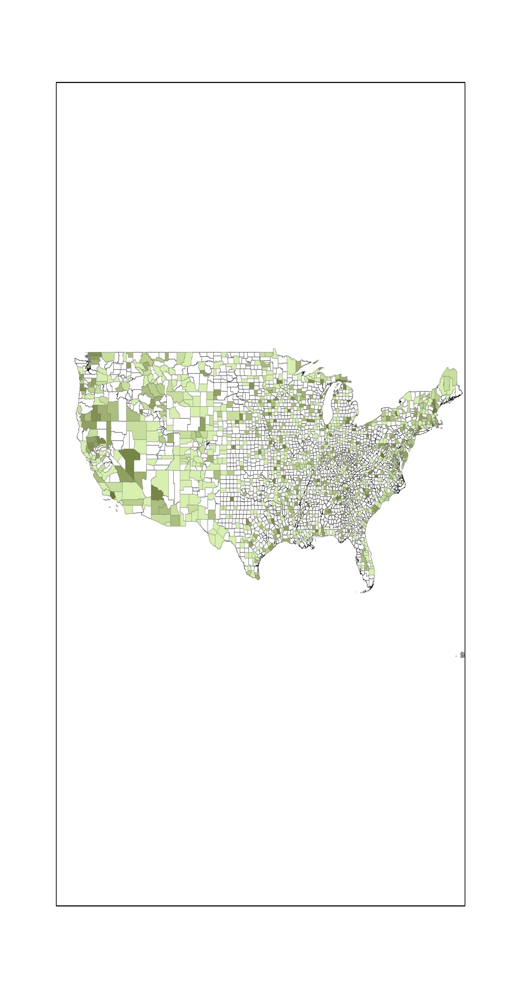
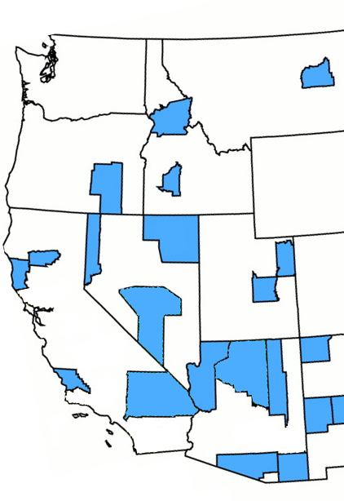
How wrong could we be?
(A)
(B)
(C)
Figure 3: (A) Agricultural land value at county level, as per USDA census data. (B) Actual acquisition cost paid by TNC at county level and over the last 40 years. (C) From Ando et al. 1998. Selected sites for coverage of 453 ESA-protected species in the US while minimizing total acquisition costs.
Ando, 1998 (Science)

Slide 6
How wrong could we be?
(A)
(B)
(C)
Figure 3: (A) Agricultural land value at county level, as per USDA census data. (B) Actual acquisition cost paid by TNC at county level and over the last 40 years. (C) From Ando et al. 1998. Selected sites for coverage of 453 ESA-protected species in the US while minimizing total acquisition costs.
Ando, 1998 (Science)

Slide 7
How wrong could we be?
(A)
(B)
(C)
Figure 3: (A) Agricultural land value at county level, as per USDA census data. (B) Actual acquisition cost paid by TNC at county level and over the last 40 years. (C) From Ando et al. 1998. Selected sites for coverage of 453 ESA-protected species in the US while minimizing total acquisition costs.
Ando, 1998 (Science)

Slide 8
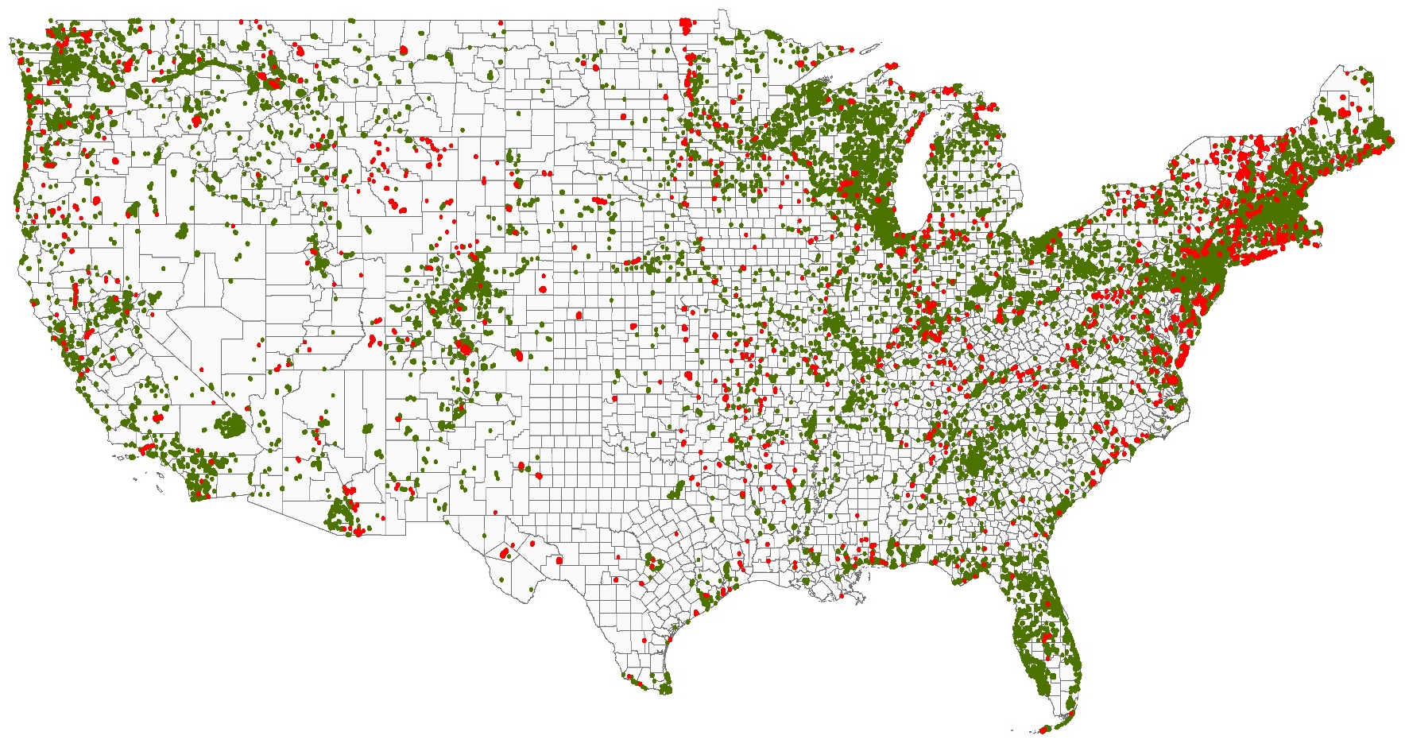
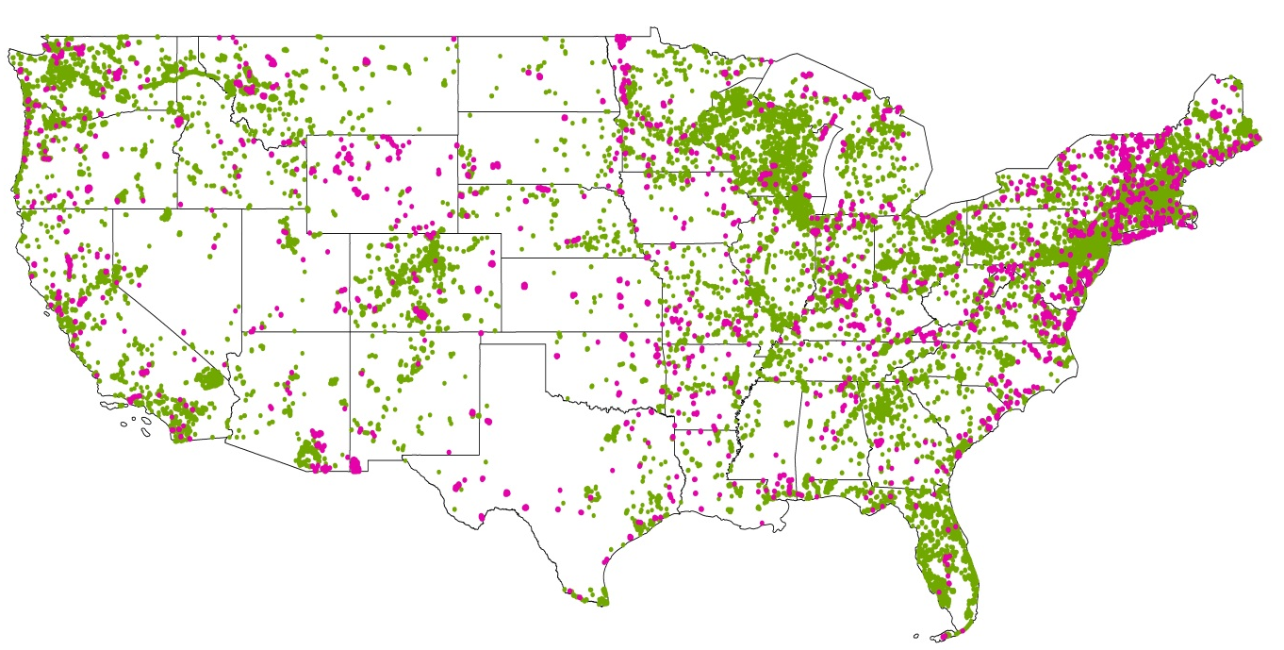
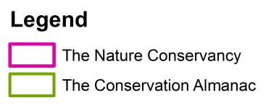
Data
Conservation land transactions recorded by The Nature Conservancy (red) and The Trust for Public Land (green) since 1970.
The Nature Conservancy
The conservation Almanac (Trust for Public Land)
= 42,000 transactions

Slide 9
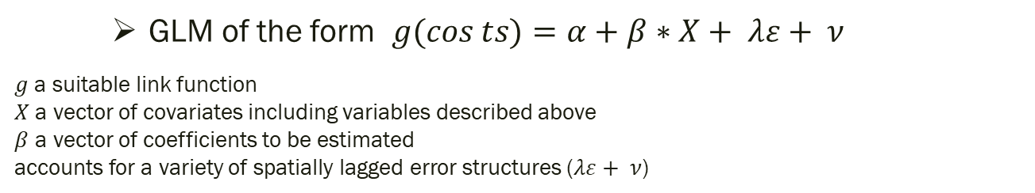
Generalized Linear Model
GLM of the form $g(cos{ts)}=α+β∗X+ λε+ ν$
$g$ a suitable link function
$X$ a vector of covariates including variables described above
$β$ a vector of coefficients to be estimated
accounts for a variety of spatially lagged error structures ($λε+ ν$)
Topology, ecology at site level:
site area
rugosity
habitat type
density of other protected areas
Socio-economic data at county level
agricultural land value
county income and poverty estimates
education

Slide 10
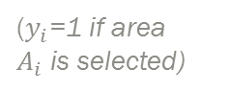
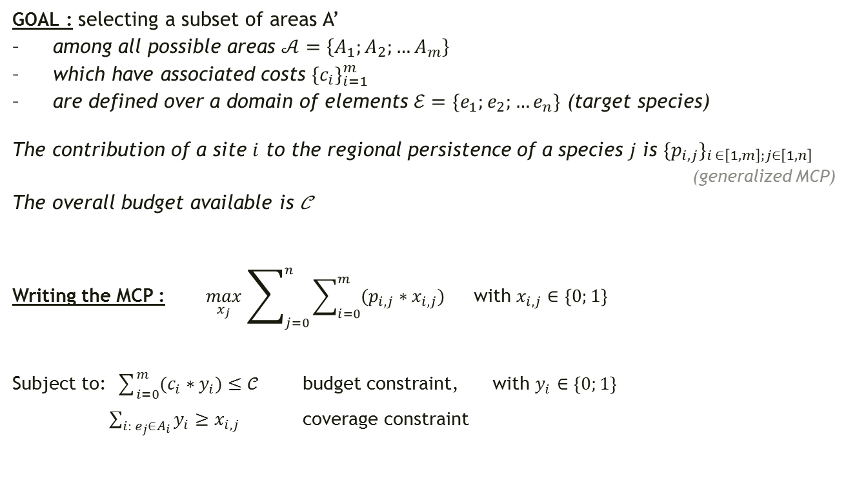
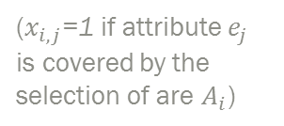
Maximum Coverage Problem
GOAL : selecting a subset of areas A’
among all possible areas $𝒜=\left\{A_{1};A_{2};…A_{m}\right\}$
which have associated costs ${\{c_{i}\}}_{i=1}^{m}$
are defined over a domain of elements $ℰ=\{e_{1};e_{2};…e_{n}\}$ (target species)
The contribution of a site $i$ to the regional persistence of a species $j$ is ${\{p_{i,j}\}}_{i ∈\left[1,m\right];j∈\left[1,n\right]}$
(generalized MCP)
The overall budget available is 𝒞
Writing the MCP : $\max_{x_{j}}{\sum_{j=0}^{n}{\sum_{i=0}^{m}{(p_{i,j}∗x_{i,j})}}}$ with $x_{i,j}∈\left\{0;1\right\}$
Subject to: $\sum_{i=0}^{m}{(c_{i}∗y_{i})}≤𝒞$ budget constraint, with $y_{i}∈\left\{0;1\right\}$
$\sum_{i: e_{j}∈A_{i}}{y_{i}}≥x_{i,j}$ coverage constraint
($x_{i,j}$=1 if attribute $e_{j}$ is covered by the selection of are $A_{i}$)
($y_{i}$=1 if area
$A_{i}$ is selected)

Slide 11
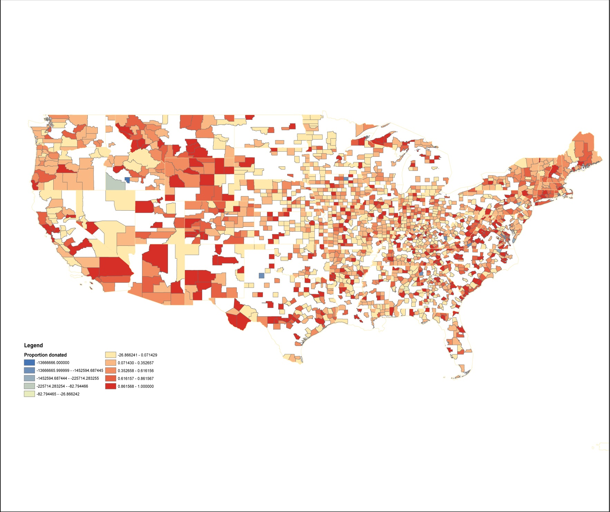

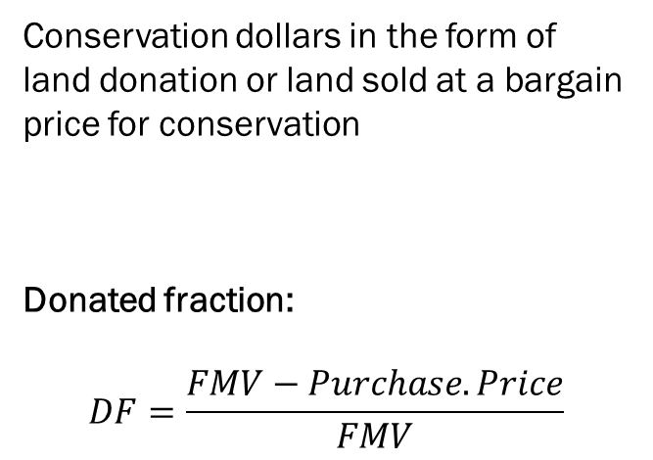
What are bargain sales?
Bargain Sales
Conservation dollars in the form of land donation or land sold at a bargain price for conservation
Donated fraction:
$$DF=\frac{FMV−Purchase.Price}{FMV}$$
Actual acquisition costs
TNC Database

Slide 12
Generalized Linear Model
In addition to the variables used in predicting actual conservation costs, additional variables such as
county income
number of dependents
population density (rurality)
education level
political alignment
Predicting the occurrence of a bargain sale and predicting the magnitude of the bargain

Slide 13
Questions
Opportunity concept

Slide 14
Questions
Opportunity concept:
How do bargain sales, philanthropic donations and democracy investments covary?

Slide 15
Questions
Opportunity concept:
How do bargain sales, philanthropic donations and democracy investments covary?
What would be an optimal blend of strategies for an organization such as TNC when starting a fundraising campaign in order to acquire a particular area?

Slide 16


Thanks!
CONTACT:
Diane Le Bouille
PhD Candidate
dlebouille@utk.edu
With the help of the Nature Conservancy
Head office staff:
Melissa Clark Joe Fargione Thomas Minney
State chapter land managers:
Chuck Byrd
Malcolm Hodges
Chris Minor
Deborah Barber
Megan Sutton
Elizabeth Johnson
Corey Giles
Kristen Austin
Marek Smith
Sam Lindblom
Braven Beaty
Mike Powell
Armsworth Lab
https://www.armsworthlab.com

